Slide 1
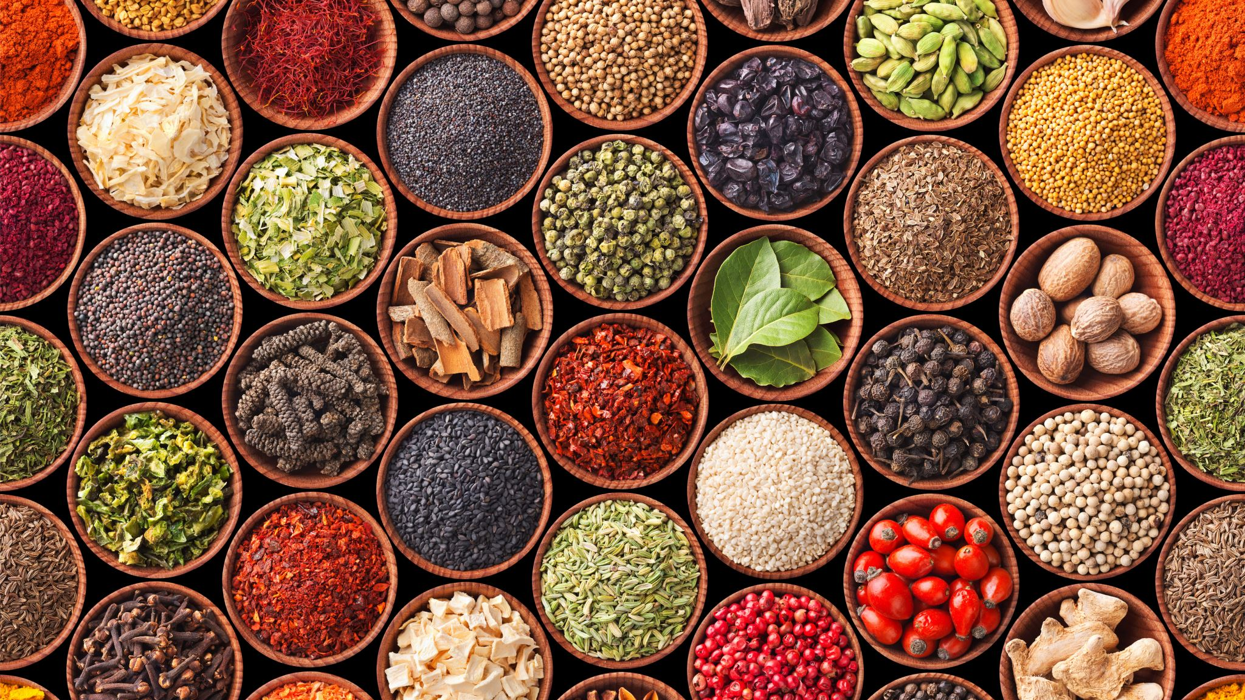
Introduction to concepts and indicators: Nutritional status & Dietary behaviour Durban, South Africa: July 13, 2023
DSI Training Programme: Climate Change, Food Systems and Remote Sensing
Isabel Madzorera, ScD
University of California, Berkeley

Slide 2
Outline of presentation
Background
Introduction to food systems
Anthropometric Assessment
Food systems, diet quality and nutrition
Nutrition-sensitive agriculture interventions
Dietary assessment

Slide 3
Background
The African continent is off-track in efforts to meet SDG 1 and 2 targets to end extreme poverty, hunger, and all forms of malnutrition
Africa has a triple burden of malnutrition
undernutrition (stunting, wasting, underweight)
micronutrient deficiencies (e.g. iron deficiency anemia, Vit A deficiency)
overweight/obesity and related non-communicable diseases (e.g. hypertension, Type 2 diabetes)
At least 278 million people are undernourished (a third of the global population)
Despite the declining prevalence, Africa is the only continent to observe an increase in stunting from 54.4M to 63.1M children (UNICEF, 2023)
Long-term effects on survival, educational performance, future earnings and human capital.
In the Horn of Africa, up to 60% of pregnant women are underweight (UNICEF Ethiopia).
Anaemia affects children <5 years (40%), pregnant women (37%) and WRA (30%) (WHO, 2019)

Slide 4
Triple burden of malnutrition in Africa: Co-existence of undernutrition, micronutrient deficiencies, overnutrition and related diseases
63.1 million children stunted
12.2 million children wasted
Increased risk of non-communicable diseases (NCDs) – e.g. diabetes, hypertension in later life
Anemia: 30% of female & 20% of male adolescents in LMICs
10.2 million children overweight
(Source: SOFI 2021, UNICEF, 2023, WB)

Slide 5
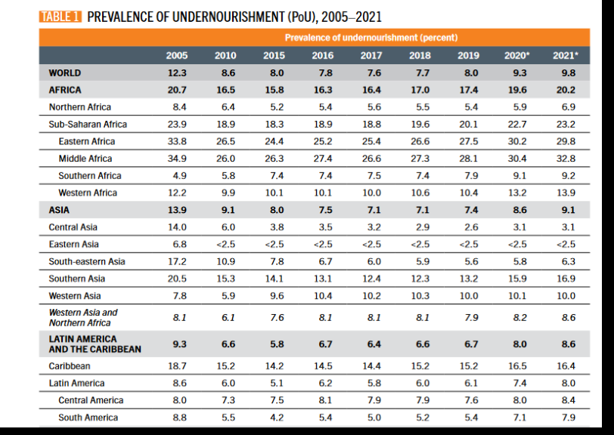
Prevalence of undernourishment in the world
Based on daily dietary energy consumption
768M people were affected by hunger in 2021; 150M more since the outbreak of COVID-19
Citations: SOFI 2022
Notes:
Based on food balance sheets. Estimates based on daily dietary energy consumption.
Reasons why hunger has increased :
Weak, stagnant or deteriorating economic conditions are underlying causes of increasing poverty and undernourishment.; Economic slowdowns and downturns
Rising consumer food prices during the pandemic
war in Ukraine is disrupting supply chains and further affecting prices of grain, fertilizer and energy.

Slide 6
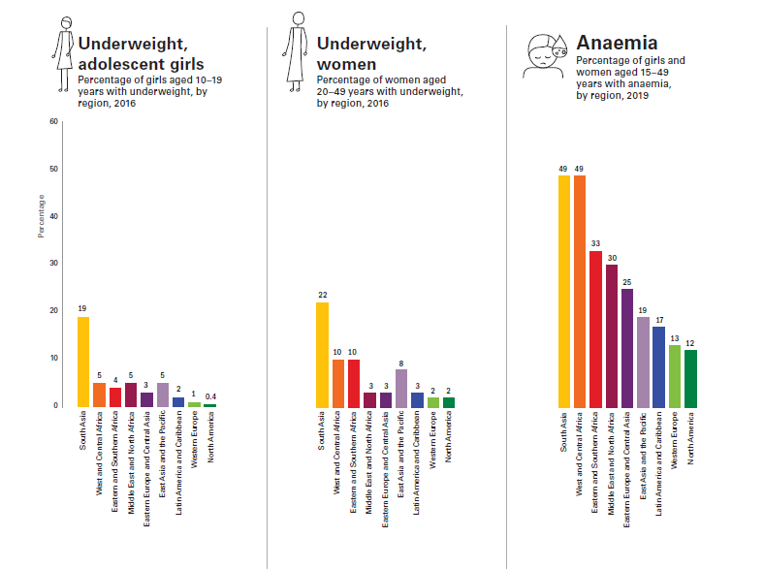
Figure: Prevalence of underweight in adolescent girls aged 10–19 years and women aged 20–49 years; anemia in adolescent girls and women aged 15–49 years; by UNICEF region
Undernourished and overlooked: A global nutrition crisis in adolescent girls and women, UNICEF 2023

Slide 7
Background
Overweight and obesity are increasing in women and children (highest in North Africa 36% in children) (UNICEF, 2023).
The rising tide of overweight and obesity is contributing to increasing rates of diet-related non-communicable diseases (NCDs).
Globally, 11 million deaths from diet-related NCDs per year can be prevented by addressing healthy diets.
At least 1 in 22 adults aged 20-79 years (24 million) in the SSA are living with diabetes in 2021. Projected to increase by 134% by 2045 (to 55 million), the largest increase in the world.
WHO estimates that the prevalence of hypertension in adults is highest in Africa (46% of adults)
significant factor in the growing global prevalence of hypertension.
Cardiovascular diseases (CVDs) are the largest contributor to the NCD burden on the African continent and are one of the leading causes of death on the continent (Minja et al. 2022).

Slide 8
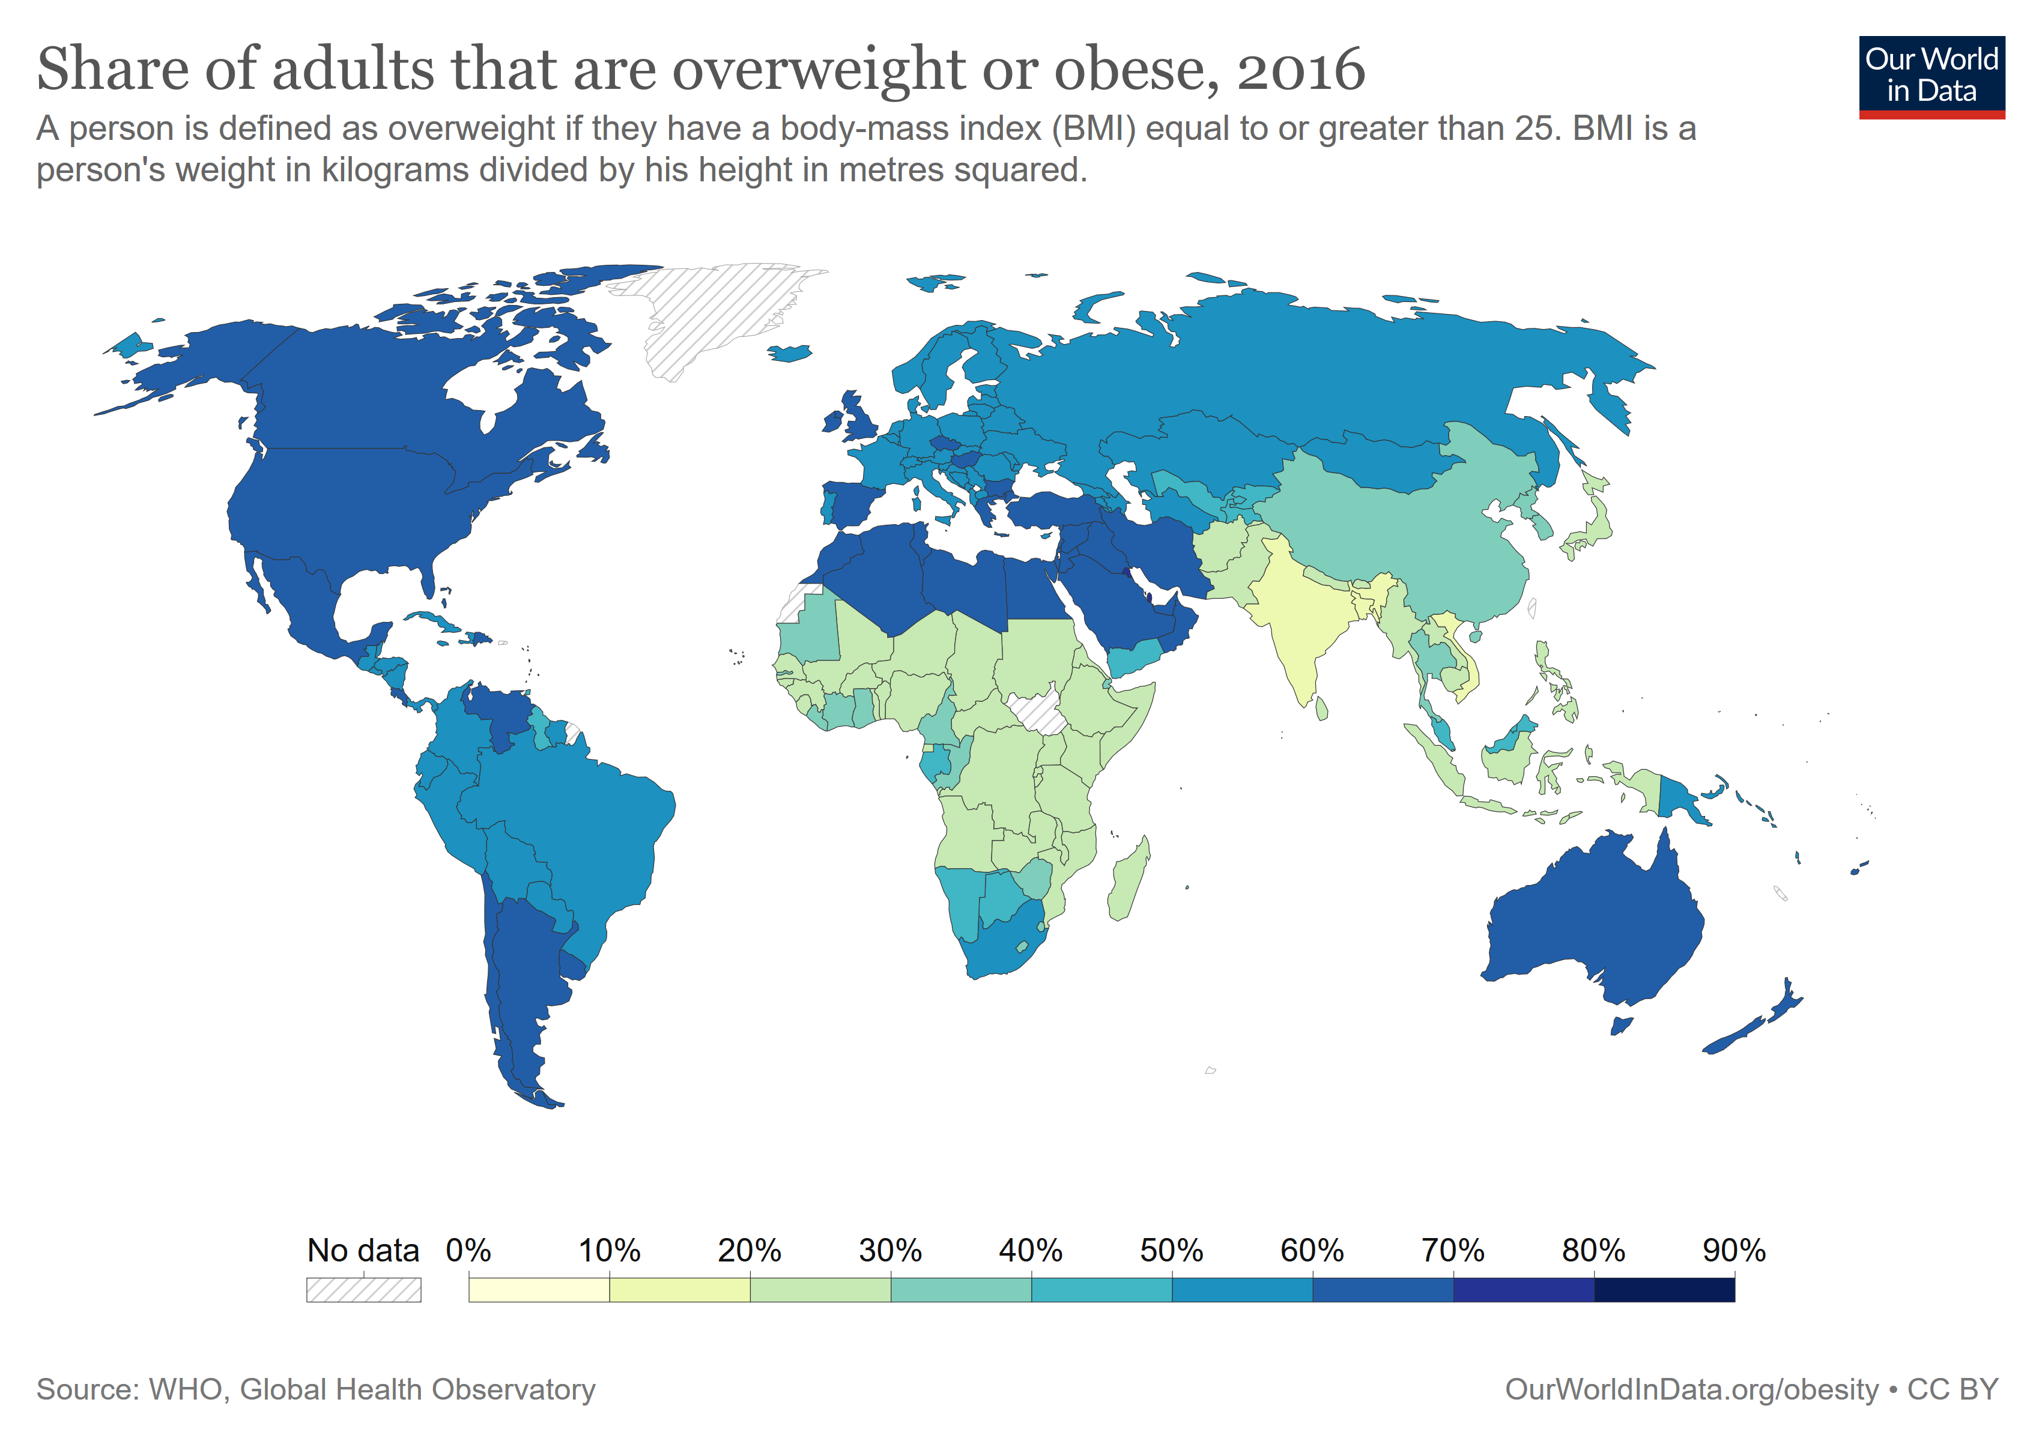
Notes:
Based on food balance sheets. Estimates based on daily dietary energy consumption.
Reasons why hunger has increased :
Weak, stagnant or deteriorating economic conditions are underlying causes of increasing poverty and undernourishment.; Economic slowdowns and downturns
Rising consumer food prices during the pandemic
war in Ukraine is disrupting supply chains and further affecting prices of grain, fertilizer and energy.

Slide 9
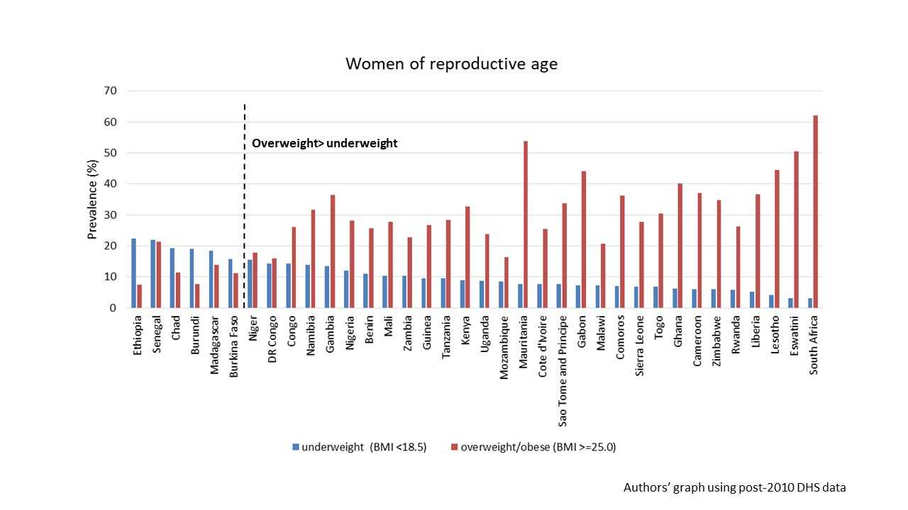
Trends in underweight and overweight among Women of Reproductive Age in Africa
Citation: Baye et al (under production)

Slide 10
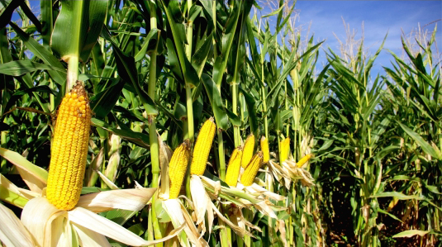
Overview of food systems
Food systems
Include all the elements (environment, people, inputs, processes, infrastructures, institutions) and activities that relate to the production, processing, distribution, preparation and consumption of food, and the outputs of these activities, including socio-economic and environmental outcomes (HLPE, 2017)
“Food systems approach” is broader than the typical focus on agriculture and “providing more food” (quantity focus)

Slide 11
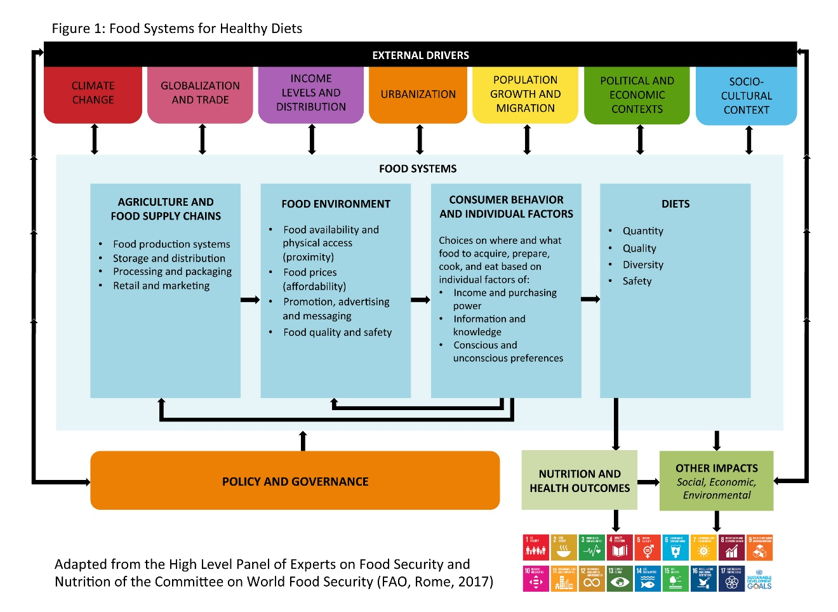
Linking Food Systems to Nutrition and Health

Slide 12
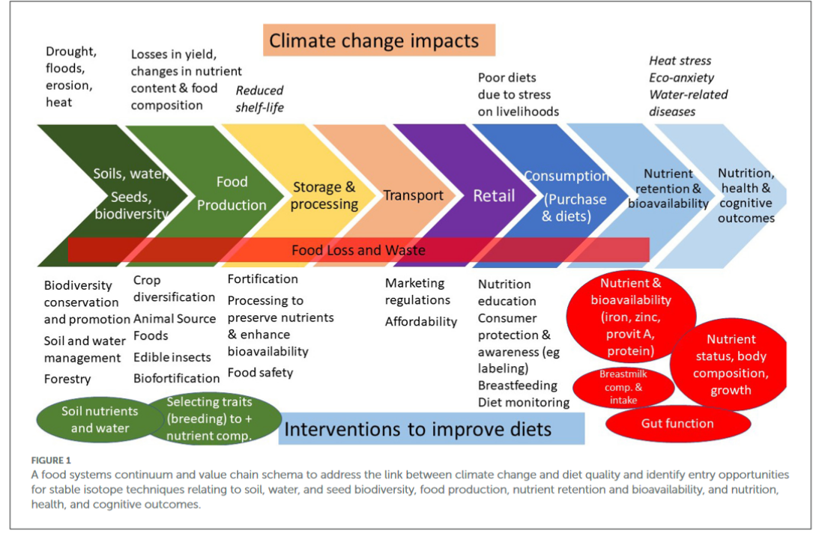
Other important challenges:
Food loss and waste
Food safety
Climate change
Owino et al, 2022

Slide 13
Food systems in Africa are challenged
A well-functioning food system should deliver safe, nutritious foods for all and at all times, provides a source of livelihood and is environmentally sustainable
Inefficiencies across food system value chains in Africa
Low crop and livestock productivity, extensive food loss and waste
Affect food & nutrition security, environmental sustainability, livelihoods, income, poverty alleviation
Nutrition and diets transition: shift in dietary practices and lower physical activity contributing to increased overweight and obesity and diet-related non-communicable diseases (NCDs)
Greater consumption of animal-source foods, processed and refined foods
Transformation of food environments in urban and rural Africa changing preferences and demand
Increased availability of cheap and nutrient-poor foods, processed and ultra-processed foods of low nutrient content, and refined and fast foods.
Notes:
To position Africa’s food systems as more resilient, sustainable, competitive and inclusive, Africa must systematically address inefficiencies in its food systems and the underlying drivers including biophysical and environmental drivers e.g., climate change, innovation technology and infrastructure

Slide 14
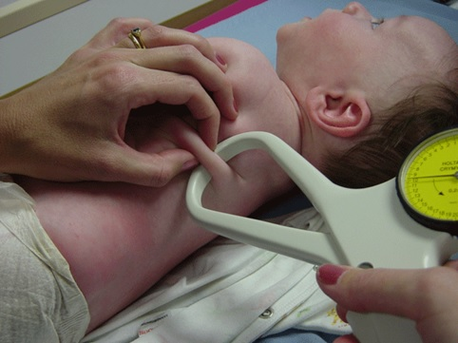
Nutrition assessment
Anthropometric assessment
Growth anthropometry
Biochemical assessment
Clinical assessment
Dietary assessment
Citations: www.mrc-epid.cam.ac.uk
Notes:
Skinfold calipers to assess body fat composition

Slide 15
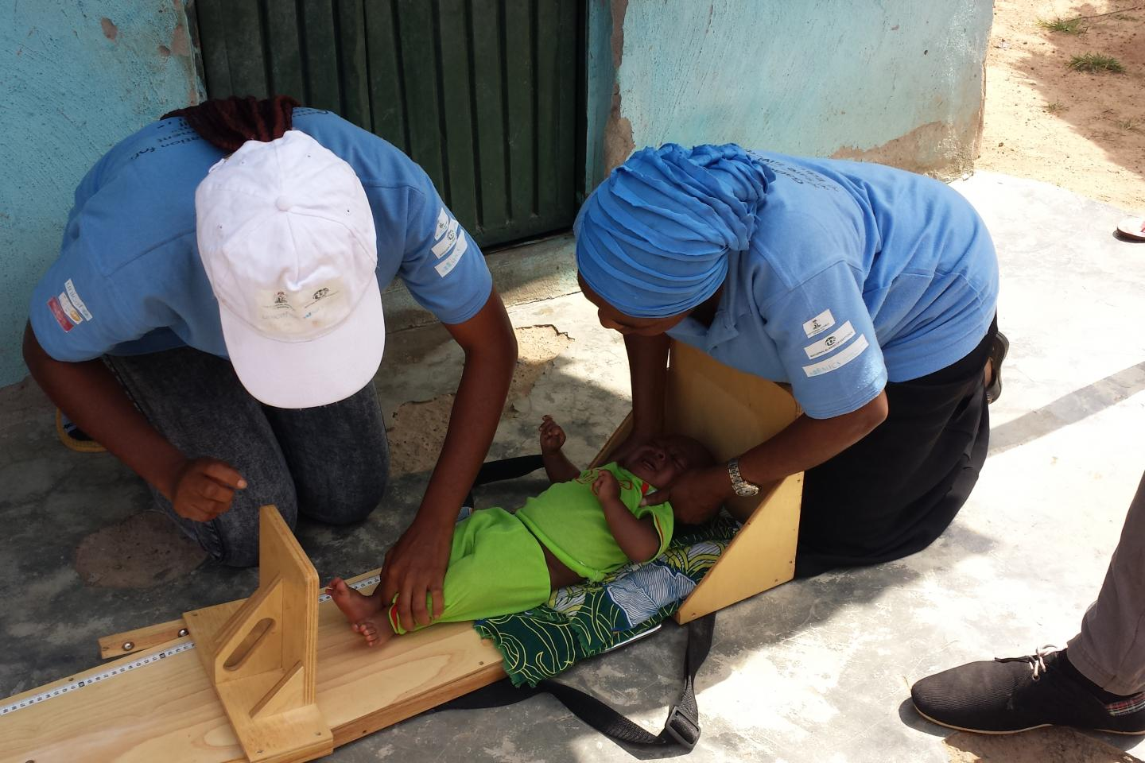
Anthropometric measures
Definition: the study of human body measurements e.g muscle, bone and adipose tissue
Common measures:
Height (or length for children <2 years)
Weight
Mid-upper arm circumference
Waist circumference
Skinfold thickness
Body mass index (BMI)
Why does it matter?
Anthropometric measures are sensitive to nutritional intakes
Associations between anthropometric measures and morbidity/mortality
Evaluates both over and undernutrition
Citations: de Onis 2006, Picture : UNICEF

Slide 16

Anthropometry
Strengths
Weight and height are commonly measured show influence of diet in the past on growth Measurements are simple, quick and inexpensive. Non-invasive Can be used to define common nutritional conditions e.g. BMI correlated with fat mass, thus overweight/obesity
 | Weaknesses
 | Some measurements may require additional training. Anthropometric measurements are not sensitive to nutrition alone. e.g. BMI may change with age, cant distinguish fat mass and muscle mass
Citations: Merriam-Webster 2016

Slide 17
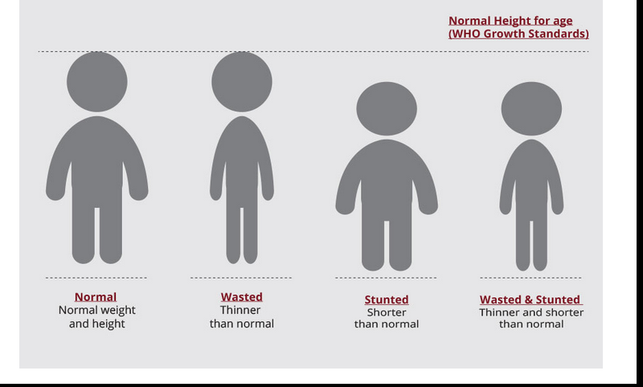
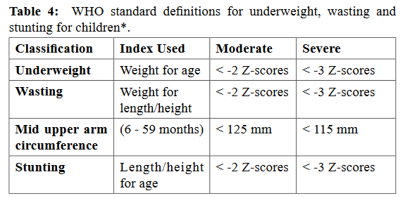
Measuring child growth
WHO Multicentre Growth Reference Study (MGRS) was undertaken 1997 – 2003
WHO growth standards from 2006: Davis, USA; Muscat, Oman; Oslo, Norway; and Pelotas, Brazil; Accra, Ghana and South Delhi, India
Citations: WHO, UNICEF 2020

Slide 18
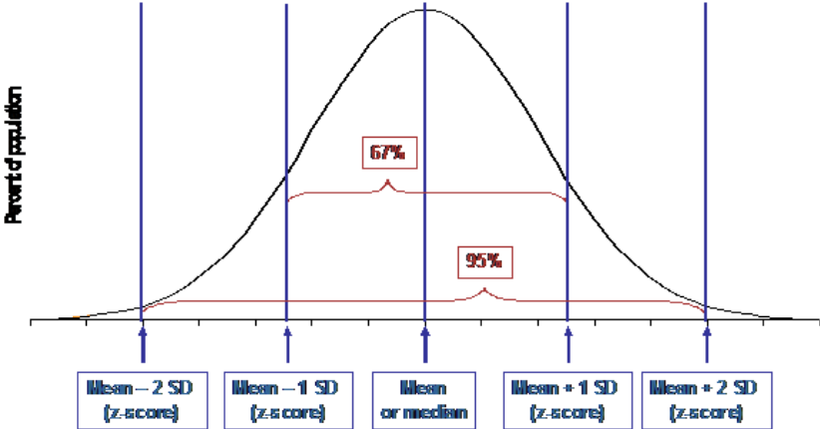
Z scores for anthropometry

Slide 19
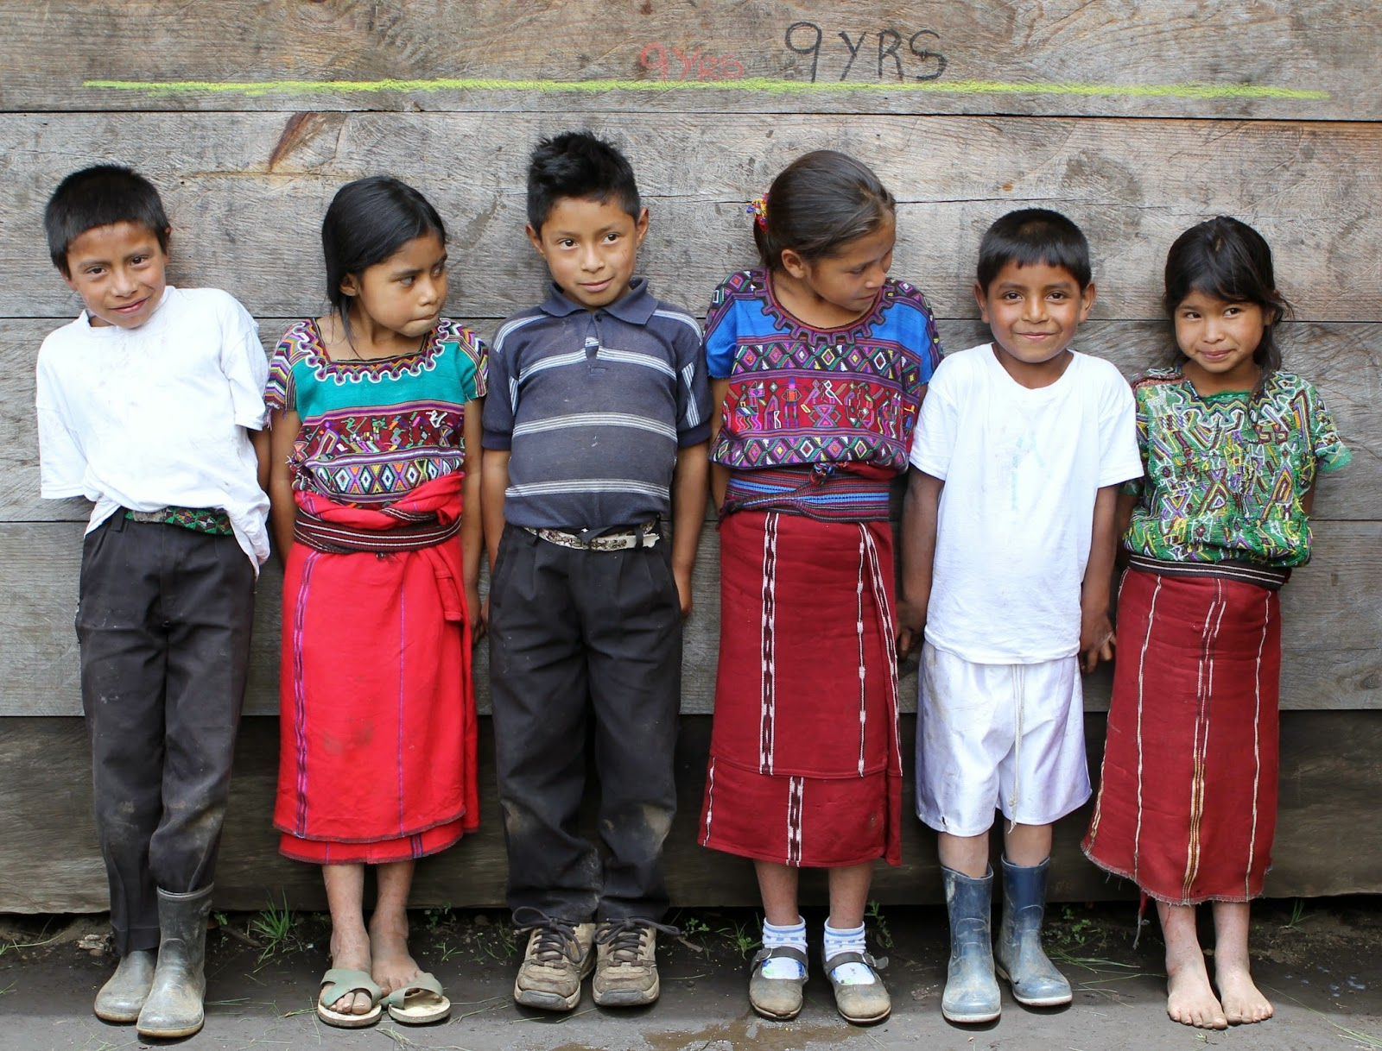
Stunting

Slide 20
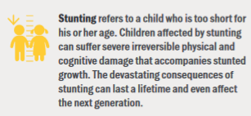
Stunting
Definition: Impaired linear growth in children due to chronic undernutrition.
Causes:
Poor maternal diet and infection during gestation.
Poor breastfeeding and complementary feeding practices.
Repeated infection, and inadequate psychosocial stimulation
Poor water, hygiene and sanitation practices
Consequences:
Increased morbidity and mortality - infections eg pneumonia, diarrhoea
Poor cognitive and physical development, low educational performance
Low adult wages, lost productivity
Increased risk of overweight/obesity later in childhood
Increased risk of nutrition-related chronic diseases in adult life
Citations: Prendergast 2014, UNICEF

Slide 21
Question 1:
What world region has the greatest number of stunted children?
South America
Sub-Saharan Africa
Southern Asia
North Africa

Slide 22
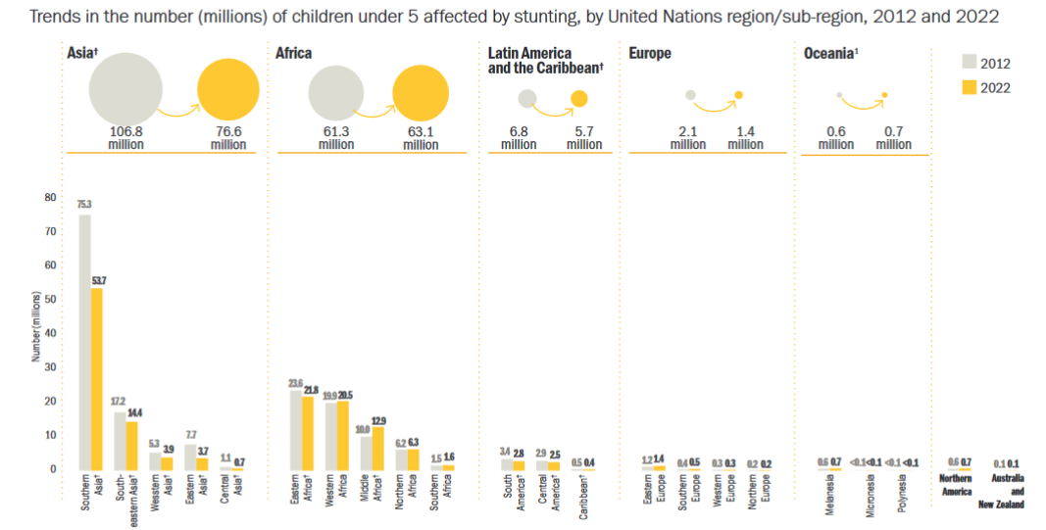
Prevalence:
Africa: 30%
Asia: 21%
Despite declining prevalence, the absolute number of children with stunting has increased in SSA (Central Africa)

Slide 23
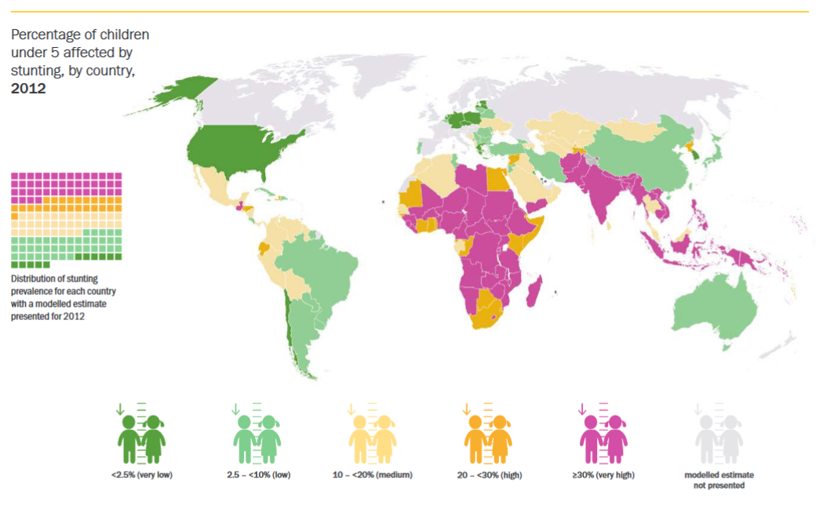
Global stunting burden (< 5y) in 2022
Citations: UNICEF/WHO/World Bank 2023
Notes:
Typo

Slide 24
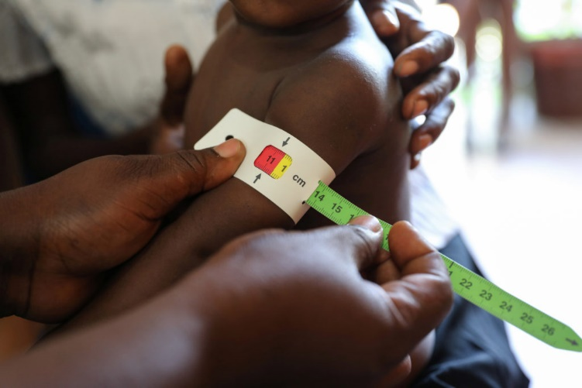
Anthropometry: Do you think this child is malnourished?
Mid-upper arm circumference

Slide 25
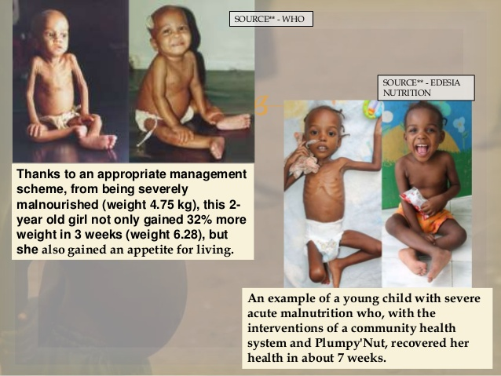
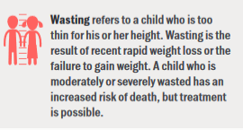
Wasting
Definition: Condition where children are too thin for their height
Also called acute malnutrition.
Severe acute malnutrition (SAM) :WHZ < -3 or MUAC <11.5cm
Causes:
Inadequate caloric intake (e.g. macronutrients)
poor dietary intake, poor absorption of nutrients eg diarrhea
Inadequate caring and feeding practices
e.g. exclusive breastfeeding or low-quality complementary food
Repeated infections
Poor access to safe water, hygiene and sanitation services
Consequences:
Increased mortality -diarrhea, pneumonia, malaria, measles
Citations: WHO 2013, Manary 2008, UNICEF

Slide 26

Wasting
Treatment & Prevention:
Therapeutic feeding
Ready to eat therapeutic foods (RUTFs) – lipid and micronutrient-based supplements
Peanut based paste e.g., Plumpynut
Inpatient treatment with special milk formulations
Prevention & treatment for infections such as diarrhea
e.g. using zinc & oral rehydration solution
Citations: Schwinger 2019, Black 2008; WHO 2013, Photo: UNICEF

Slide 27
Question 2:
What world region has the greatest prevalence of wasting in children?
South America
Sub-Saharan Africa
South Asia
North Africa

Slide 28
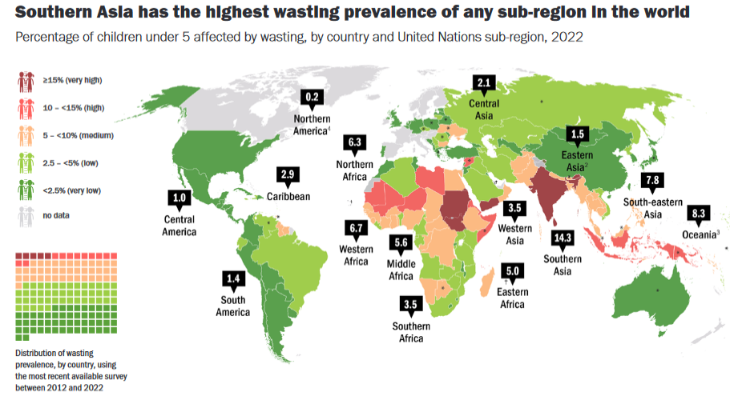
Global wasting burden (< 5y)
Citations: UNICEF/WHO/World Bank 2023

Slide 29
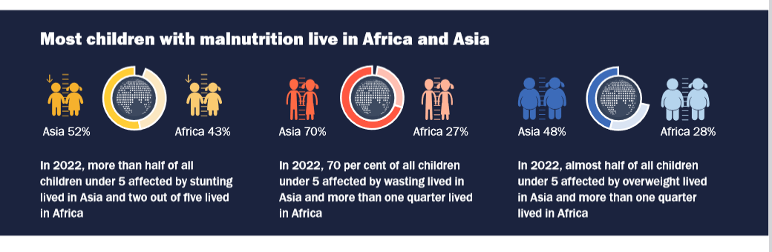
Summarizing burden of child malnutrition
Citations: UNICEF 2023

Slide 30
Measuring overweight with BMI
CDC definitions for adult overweight and obesity, WHO definitions for all else.
 | Children <5 y | Children 5-19 y | Children and adolescents (CDC) |  | Adults
Underweight |  |  | BMI for age and sex < 5th percentile |  | BMI<18.5kg/m²
Overweight | WHZ>2 | WHZ>1 | 85th to less than the 95th percentile |  | 25 ≤ BMI < 30 kg/m²
 |  |  |  |  | (Class I) 30 ≤ BMI < 35 kg/m²
Obese | WHZ>3 | WHZ>2 | 95th percentile or greater |  | (Class II) 35 ≤ BMI < 39 kg/m²
 |  |  |  |  | (Class III) BMI ≥ 40 kg/m²
Adult body mass index (BMI): weight(kg)/[height(m)]²
Citations: WHO 2016; CDC 2016

Slide 31
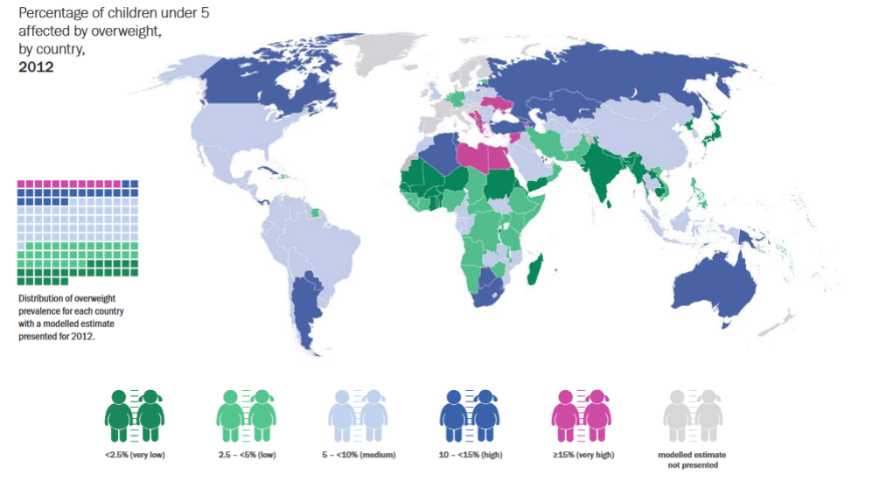
Global overweight burden children (< 5y)
Citations: UNICEF/WHO/World Bank 2023

Slide 32
Overweight/Obesity
Proxy for metabolic syndrome
Causes:
Lifestyle factors, e.g. low quality diets, low physical activity, irregular sleep.
Genetics and diseases (e.g. hypothyroidism)
Medications can contribute
Unhealthy food environments eg food deserts
Consequences:
Increased risk of morbidity and mortality
Associated with diet-related NCDs e.g. type 2 diabetes mellitus, coronary heart disease and stroke, some cancers etc
Adverse psychosocial effects (e.g. depression).
Citations: WHO 2016c; Roberto 2015

Slide 33
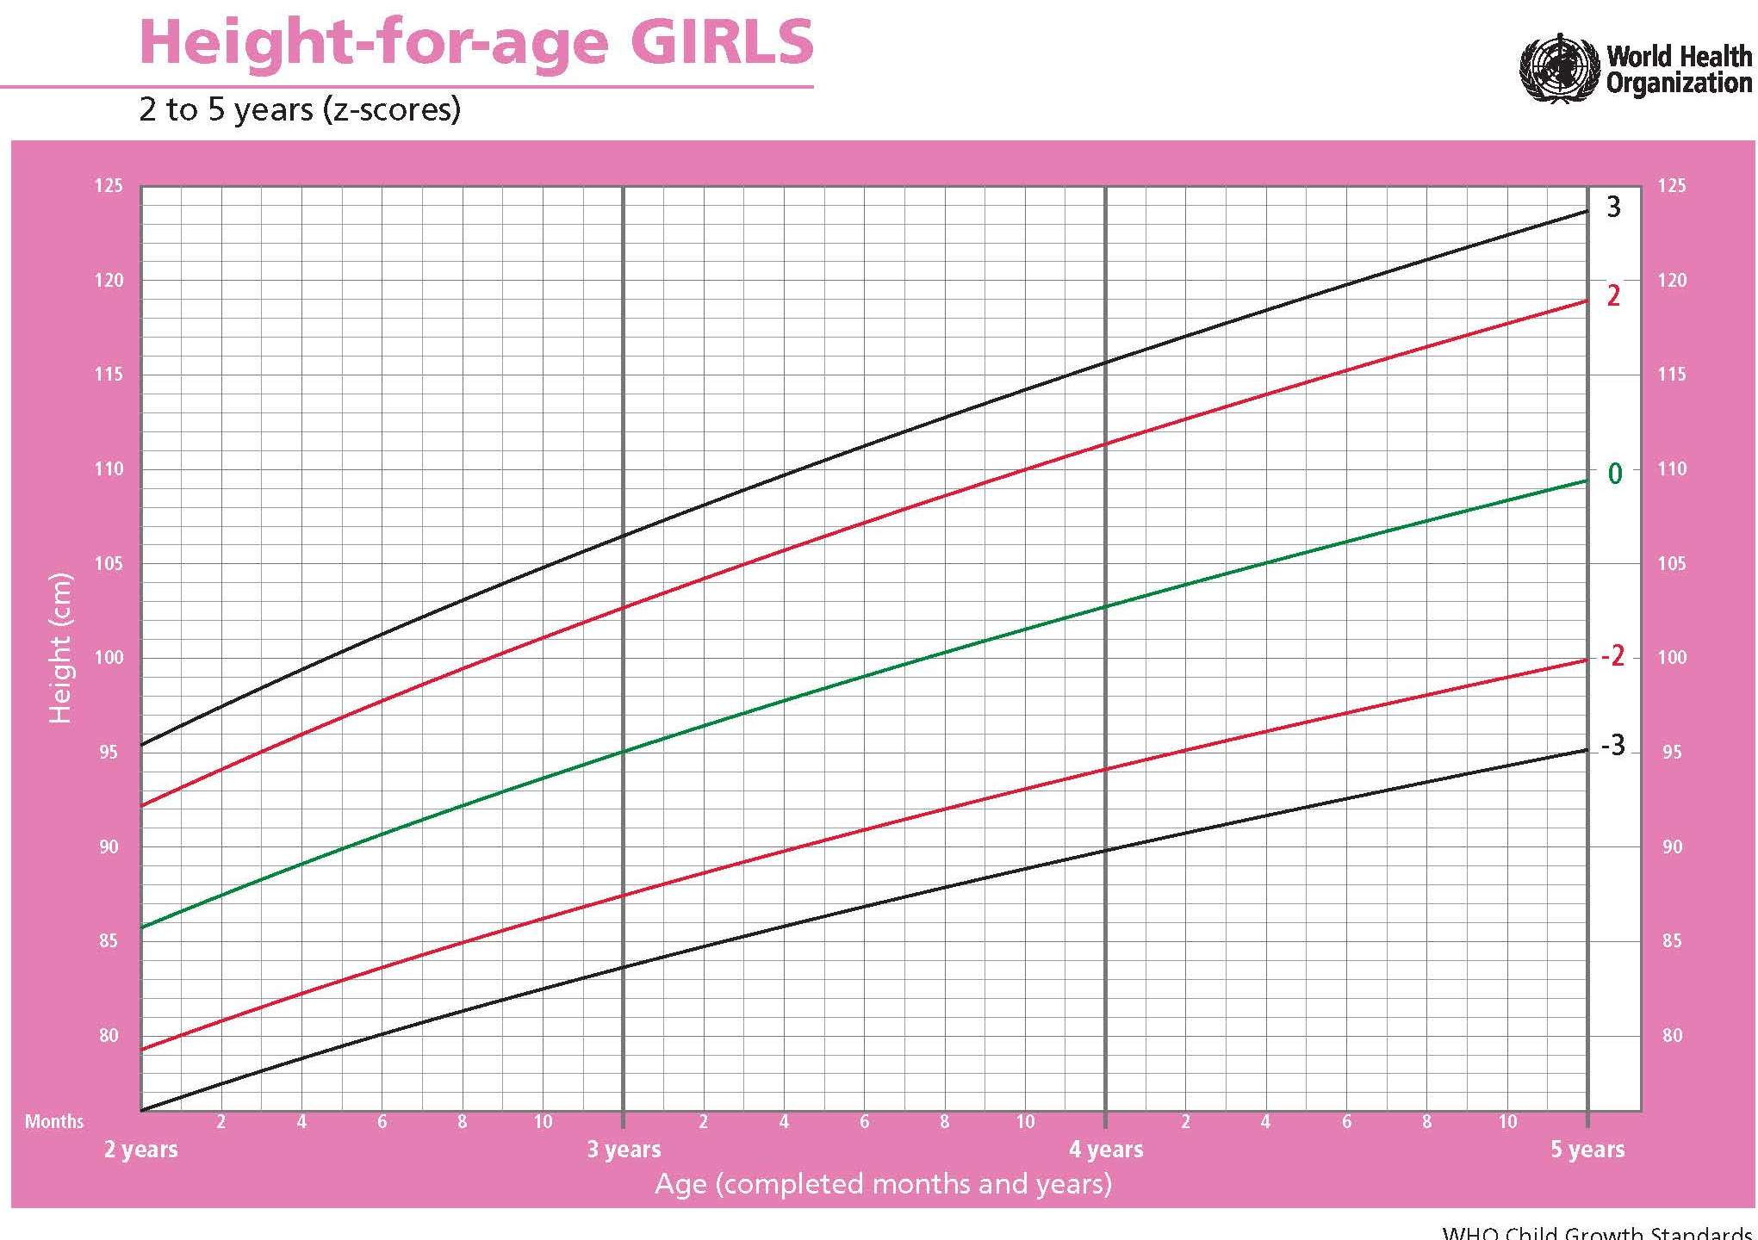
SAS exercise: computing child growth indices

Slide 34
Resources for anthropometry
Children
https://www.who.int/tools/child-growth-standards
https://www.who.int/tools/child-growth-standards/software
https://cdn.who.int/media/docs/default-source/child-growth/child-growth-standards/software/anthro-pc-manual-v322.pdf?sfvrsn=c4e76522_2
Adolescents
https://www.who.int/tools/growth-reference-data-for-5to19-years/indicators/bmi-for-age

Slide 35
Types of nutrition assessment
Anthropometric assessment
Growth anthropometry
Biochemical assessment
Clinical assessment
Dietary assessment

Slide 36
Nutrition epidemiology
Definition: examines dietary or nutritional factors in relation to disease occurrence in populations.
Epidemiological methods have been used to study the relationship between diet and disease
Findings from nutritional epidemiology used in guiding dietary recommendations for the prevention of non-communicable diseases (e.g., cardiovascular disease, hypertension, diabetes, cancer etc).
Citations: McCullough and Giovannucci, 2006

Slide 37

Nutrition assessment methods: Dietary assessment
Diet record
24Hr dietary recall
Food frequency questionnaire

Slide 38

Diet record
Objective
Measure current diet
Validate other dietary assessment methods - gold standard
eg 7-day weighed diet record
Structure
Record all foods and beverages consumed in one or more days
Food intake recorded by participant at time of intake
Detailed description of food, preparation method and quantities required.
Quantities are weighed & volume measured

Slide 39
Question
You are asked to record and weigh all the foods you eat and drink over the next 7 days. What challenges can you anticipate?

Slide 40
Diet record
Strengths |  | Weaknesses
Gold standard* Quantitatively accurate Memory not required (not subject to recall bias) Open ended, gives most complete data, less likely to omit food |  | Participants require substantial training Requires literacy and motivation May alter usual eating habits Participants may not record foods eaten right away Creates a burden on participants, e.g. fatigue High cost Multiple days required to estimate “usual intake” Seasonality

Slide 41
24-hour dietary recall
Objective
Measure current average diet of a group or population
Assesses mean nutrient intake
Compare intake with recommendations
Often used in field studies globally
Structure
Recall and report food and beverage intake in preceding 24 hours
Administered by trained interviewer.
Typically includes an estimate of quantities consumed

Slide 42
Activity – 5 mins
Divide the session into pairs
Select 1 person in your pair to be a respondent and the other person will be the interviewer
Interviewer: Ask your partner to detail EVERYTHING they ate between 7am yesterday and 7 am this morning.
Probe for additional foods and beverages
Once you have completed the 24-hour recall, make a list of the strengths and weaknesses of this approach.
Report back to the class on what strengths and weaknesses you noticed.
Notes:
Assign participants into breakout rooms for 5 minutes
Include a report-back before we go to the next slide

Slide 43
24-hour recall
Strengths |  | Weaknesses
Quick and easy to administer Can be administered in person, on the phone, etc. Low respondent burden Literacy is not required for respondent No restrictions on foods that can be reported Long-term memory not required. Does no interfere with eating behavior. |  | Requires a well-trained interviewer. Relies on accurate memory. Age, memory Can result in recall error, e.g. recall bias Subject may selectively recall “good foods” foods and exclude those considered “bad” Quantification of portion sizes requires portion size aids Subject to day to day variation Multiple 24Hr recalls needed to represent the usual diet.

Slide 44
Food frequency questionnaire (FFQ)
Objective
Measure usual intake, i.e. long-term diet
Measure individual nutrient and food intake
Relative ranking of intake is priority
Structure
Food list includes foods that are consumed reasonably often, have substantial nutrient content, or those whose intake varies between subjects.
Record the frequency of consumption of the listed foods and beverages, and portion sizes
Specific recall period eg 7 days or 30 days
Can be administered by interviewers (eg LMICs) or self-administered

Slide 45
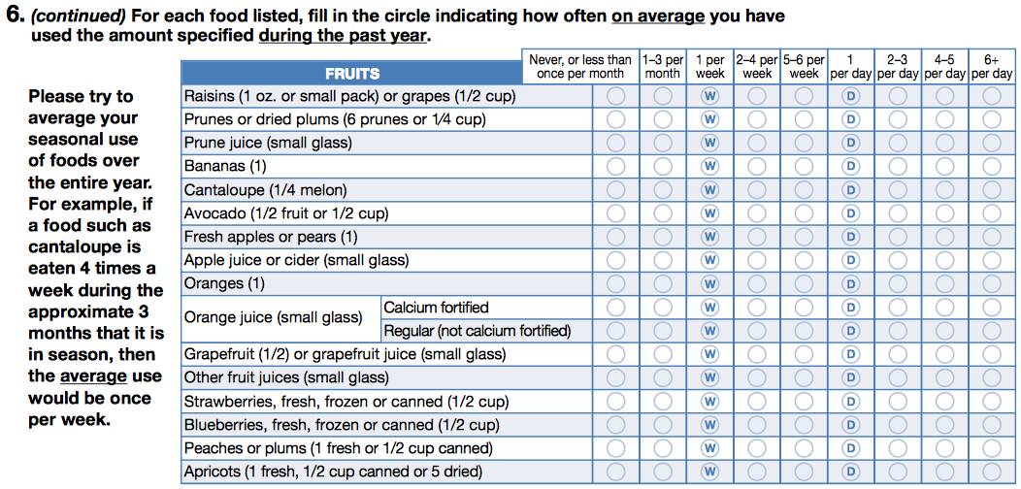
Food frequency questionnaire (FFQ) example
Citations: Willett 2007
Nurses Health Study

Slide 46
Food frequency questionnaire
Strengths |  | Weaknesses
Relatively inexpensive and easy to administer Can be self-administered and computer processed Useful for large epidemiologic studies, measures usual intake Compares people with high vs low intake of nutrients/dietary patterns Well-established validity |  | Recall of foods may be inaccurate – recall bias Often not transferrable across cultures/populations, e.g. may miss important foods from the list Not ideal for estimating absolute intake E.g. may underestimate energy intake Requires literacy if self administered Tedious for the participant

Slide 47
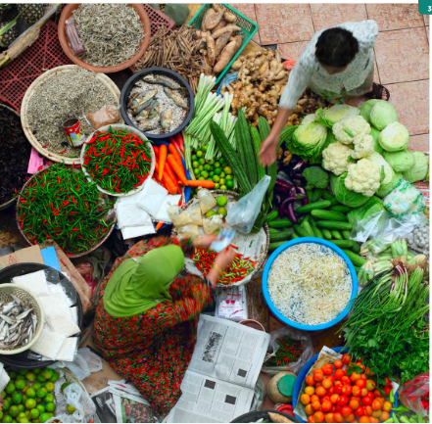
Diets and malnutrition
Sub-optimal diets are the number one risk factor for mortality (Murray, 2020)
11M deaths attributable to dietary risk factors and sub-optimal diets
Characterized by low intake of whole grains, fruits, nuts and seeds, and excess sodium intake (Afshin et al, 2019)
Obesity and diet-related chronic diseases
e.g. diabetes, cardiovascular disease, cancer
Undernutrition (stunting, wasting and micronutrient deficiencies)
Notes:
https://www.anh-academy.org/sites/default/files/FEWG_TechnicalBrief_low.pdf

Slide 48
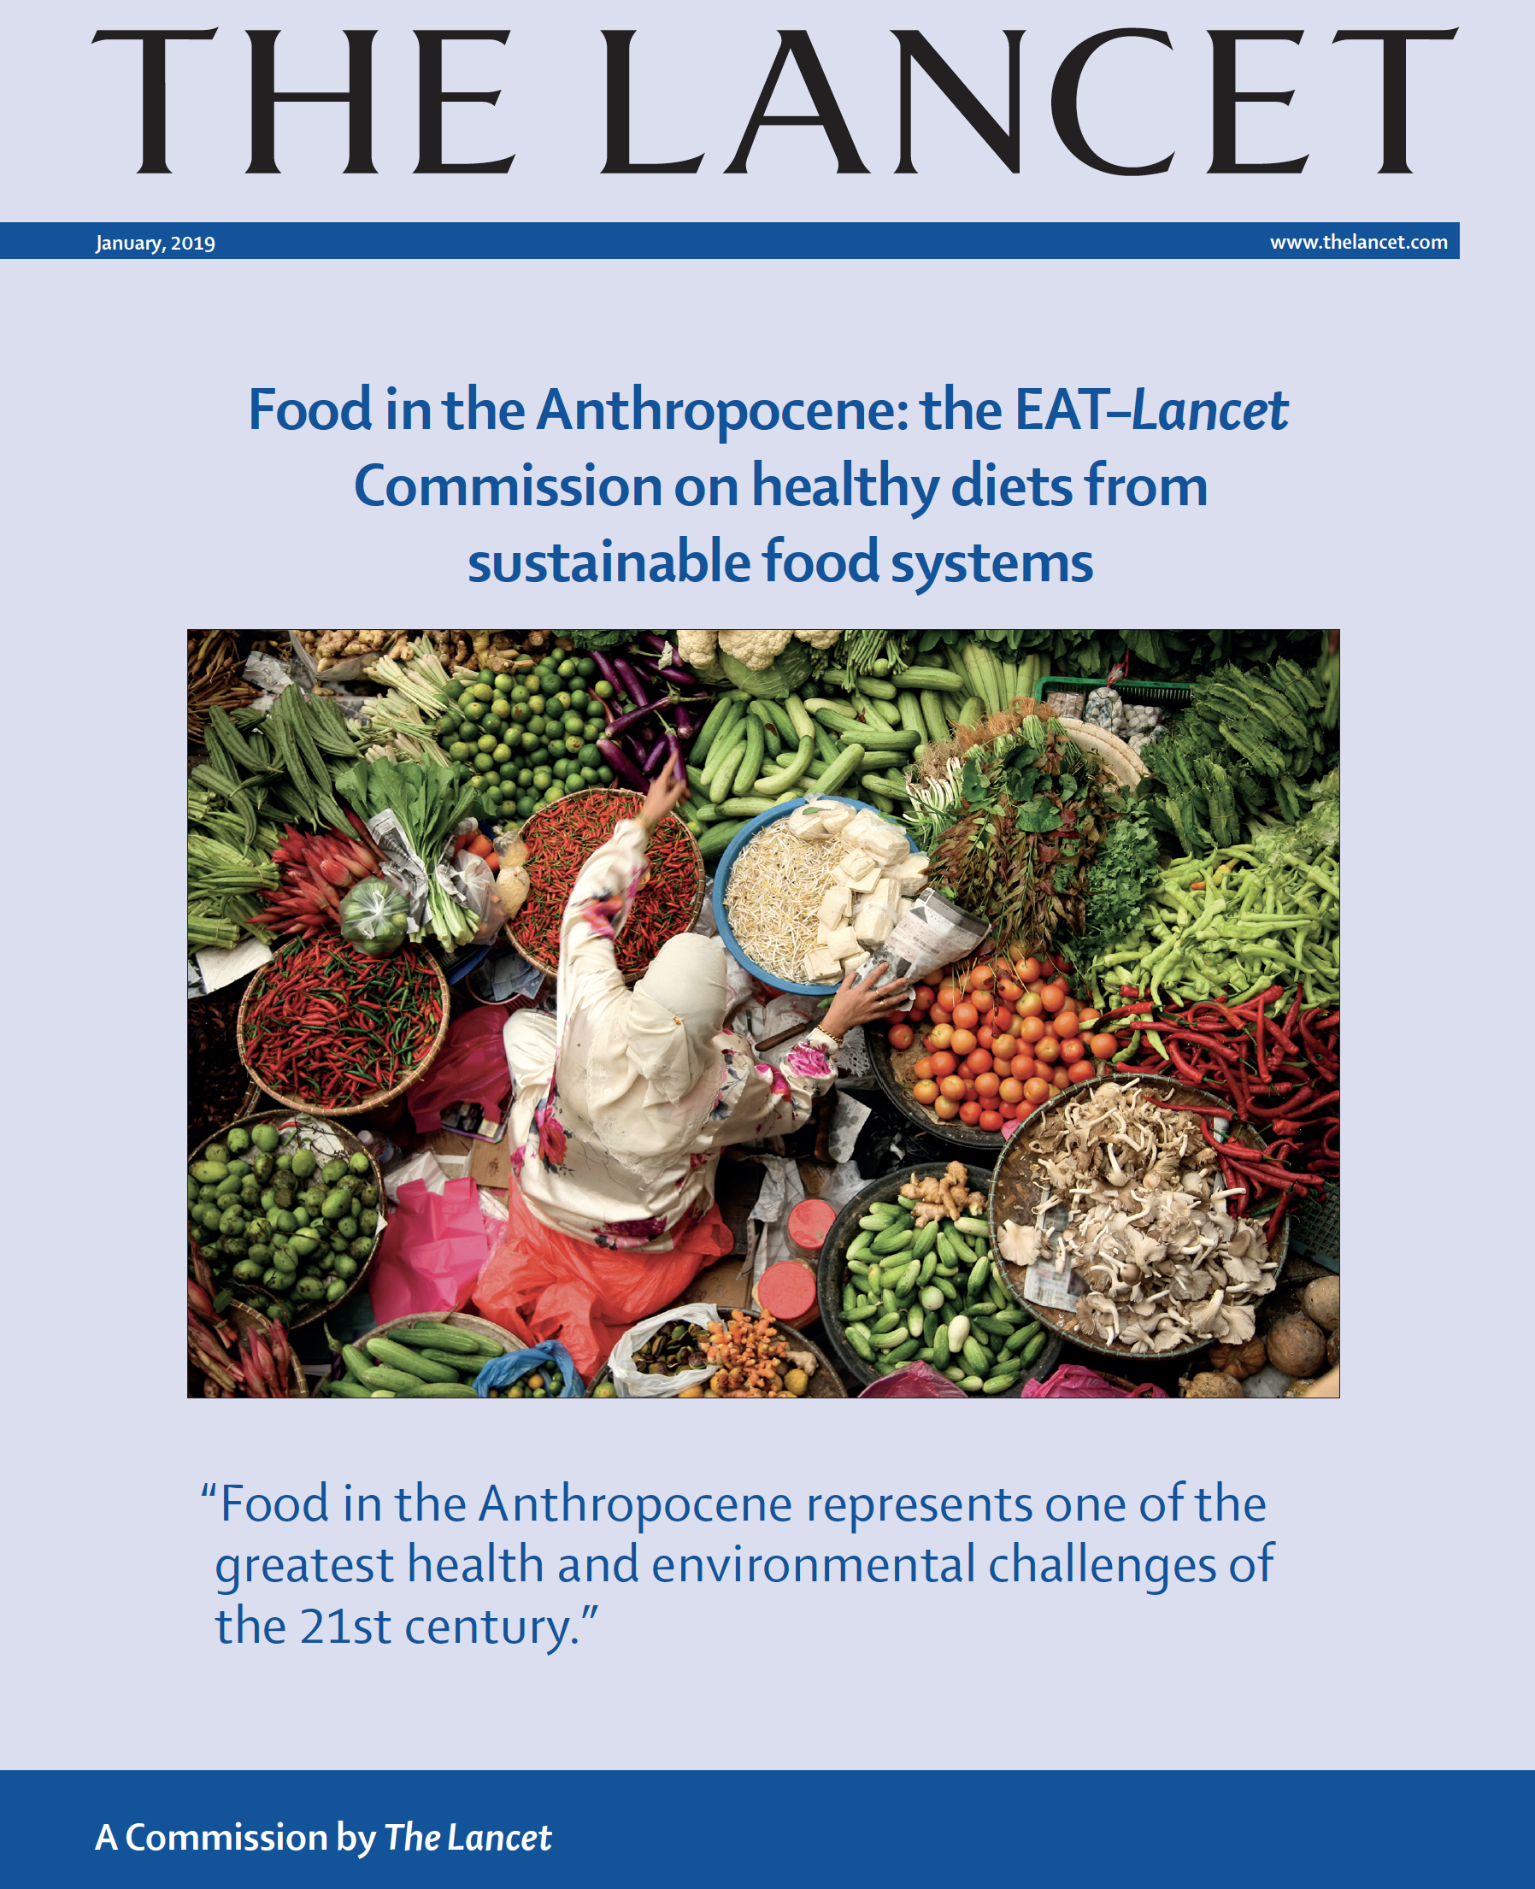
Food systems and Sustainable Diets
48
Global food systems are failing to deliver nutritious and healthy diets in an equitable manner
“Providing a growing global population with healthy diets from sustainable food systems is an immediate challenge.”
Low-quality diets cause micronutrient deficiencies and contribute to a substantial rise in the incidence of diet-related obesity and non-communicable diseases, including coronary heart disease, stroke and diabetes
Willett et al, 2019
48

Slide 49
Question 3:
Is the consumption of red and processed meat associated with a higher risk of cardiovascular diseases?
Yes
No
Don’t know

Slide 50
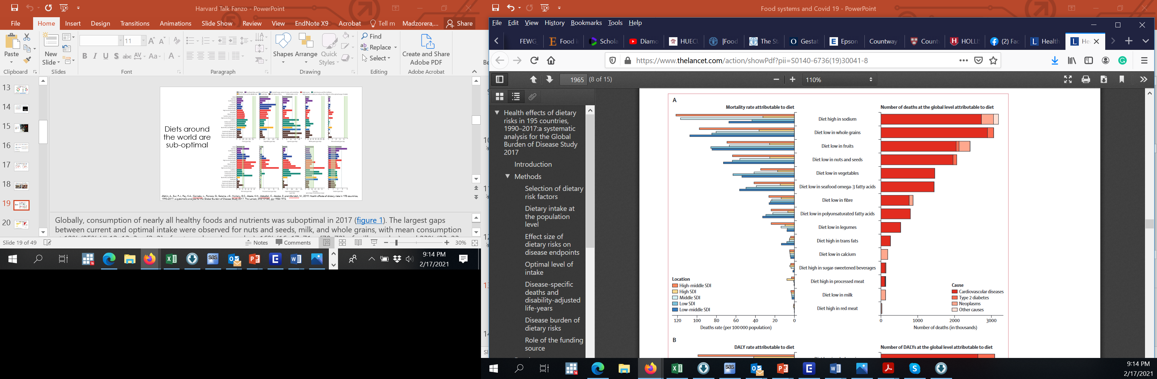
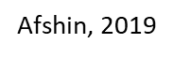
Deaths attributed to dietary factors
The Lancet 2019 3931958-1972DOI: (10.1016/S0140-6736(19)30041-8)
Notes:
https://www.thelancet.com/action/showPdf?pii=S0140-6736%2819%2930041-8

Slide 51
FAO Minimum Diet Diversity Index - Women (MDD-W)
Maternal diet diversity
Composed of 10 food groups
MDD-W
Starchy staple foods
Beans and peas
Nuts and seeds
Dairy
Eggs
Flesh foods
Vitamin A-rich dark green leafy vegetables
Other vitamin A-rich vegetables and Fruits
Other vegetables
Other fruits
Validated for micronutrient adequacy
Vit A, thiamin, riboflavin, Vit B6, B12, folate, zinc, calcium, iron
[Martin-Prével et al, 2015 Arimond et al, 2010]
Gap:
MDD-W measures one aspect of diet quality (micronutrient adequacy)
Does not capture global dietary transition and consumption of unhealthy foods in LMICs

Slide 52
Prime diet quality score (PDQS) 21 food groups (score range 0-42)
Healthy (14)
dark green leafy vegetables | other vit A rich vegetables
cruciferous vegetables | other vegetables
whole citrus fruits | other fruits
fish | poultry
legumes | nuts
low fat dairy | whole grains
eggs | liquid vegetable oils
Unhealthy (7)
red meat | processed meats
refined grains and baked goods | sugar sweetened beverages
desserts and ice cream | fried foods away from home
potatoes, roots and tubers
PDQS
Healthy food groups: | Unhealthy food groups:
0–1 serving/week (0 points) | 0–1 serving/week (2 points)
2–3 servings/week (1 point) | 2–3 servings/week (1 point)
≥4 servings/week (2 points) | ≥4 servings/week (0 points)
Evidence for: Cardiovascular disease [Fung et al, 2018; Alvarez-Alvarez et al, 2020]
Gestational diabetes, hypertensive in pregnancy [Gisevic et al, 2018]

Slide 53
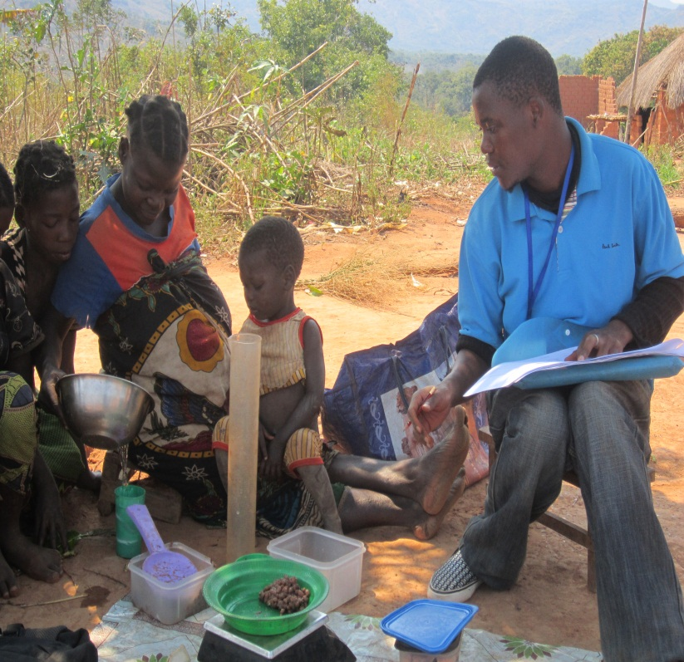
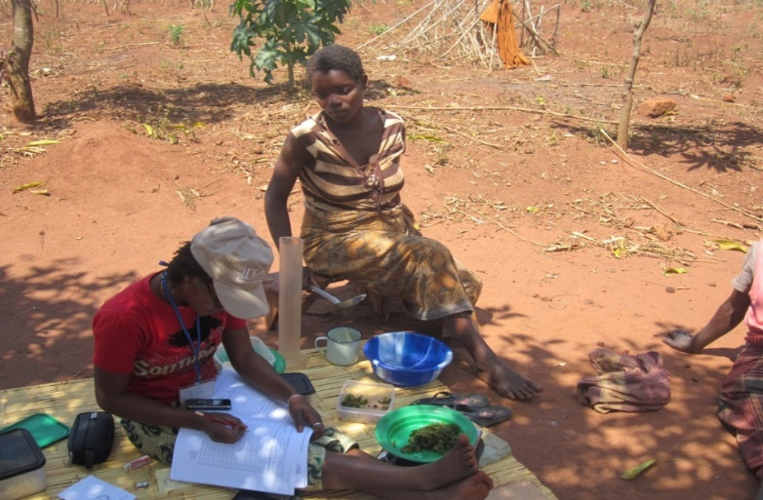
Thank you
Contact: imadzorera@berkeley.edu

